Slide 1
| MedicareCENTER Upcoming Features |

Slide 2
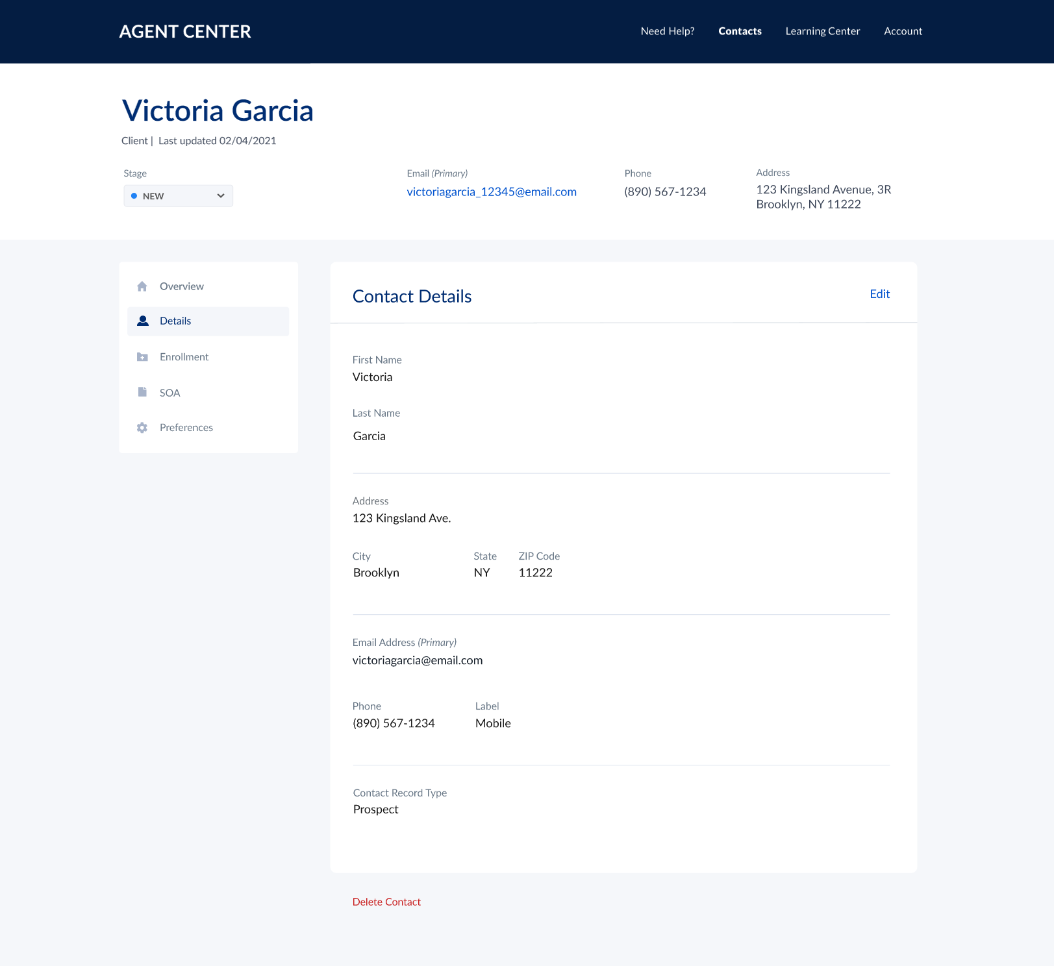
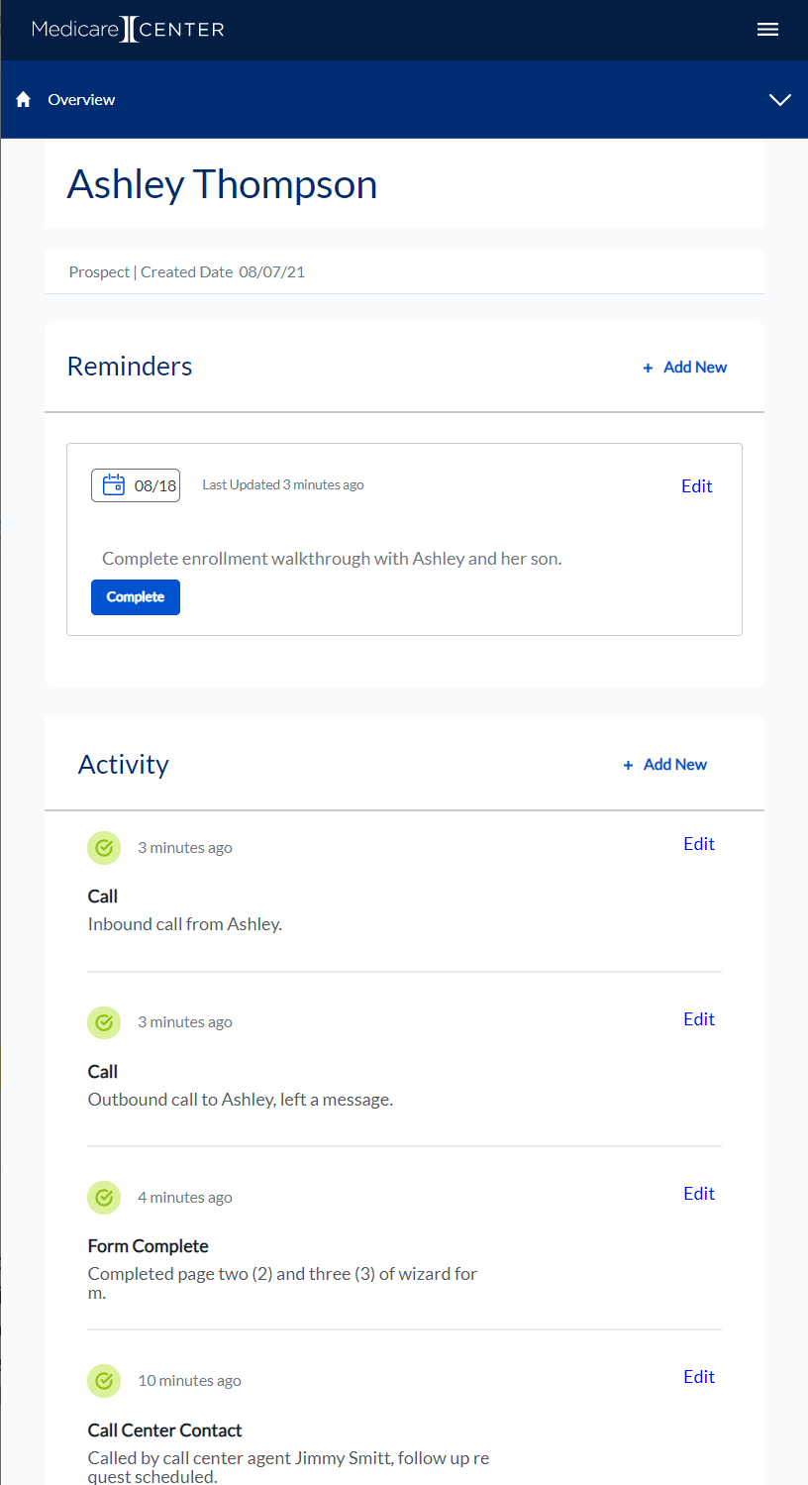
MedicareCENTER is the smart and simple client experience management platform, provided FREE to you!
Track client history, quote and enroll faster—and engage anywhere using our suite of solutions this AEP.
MedicareCENTER features include:
Easy-to-use CRM
Integrated Quote & Enroll—using eApps
CMS-compliant call recording, storing & downloading (coming soon!)
Mobile App (coming soon!)
Extensive LearningCENTER
And more – available FREE to our agents!

Slide 3
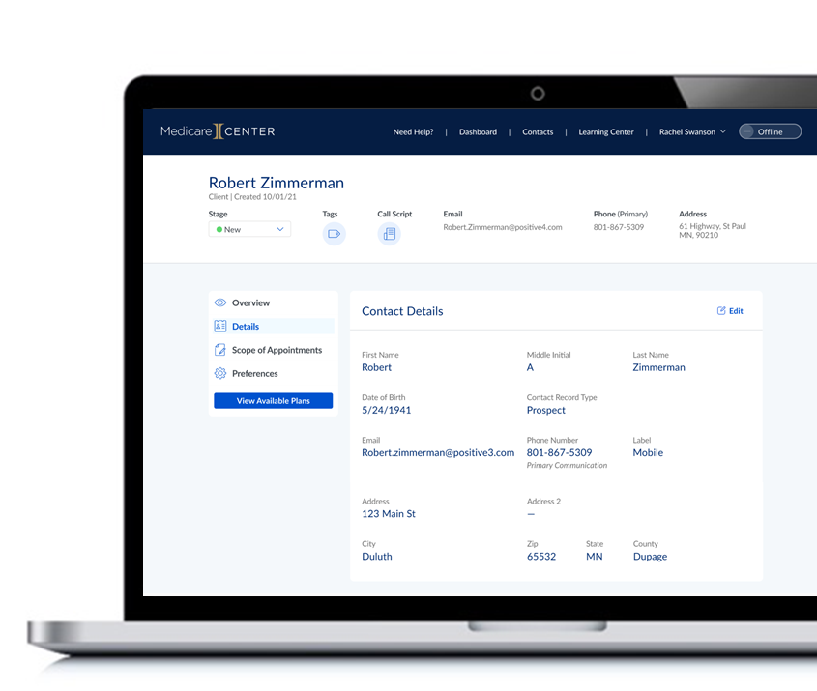
CMS Required Call Recording
We all know the news! CMS is requiring Medicare agents to record the sales calls they have with clients and keep the recordings connected to the specific client they serve.
We’re excited to share—that there’s a smart and simple way for you to meet these requirements:
MedicareCENTER offers a powerful call recording solution for you!
With MedicareCENTER Call Recording, it’s easy to seamlessly record all your client calls.
Store the recordings automatically and securely for the full 10-year period required by CMS.
Download calls anytime you need to, from wherever you’re working.
Notes:
Jake

Slide 4
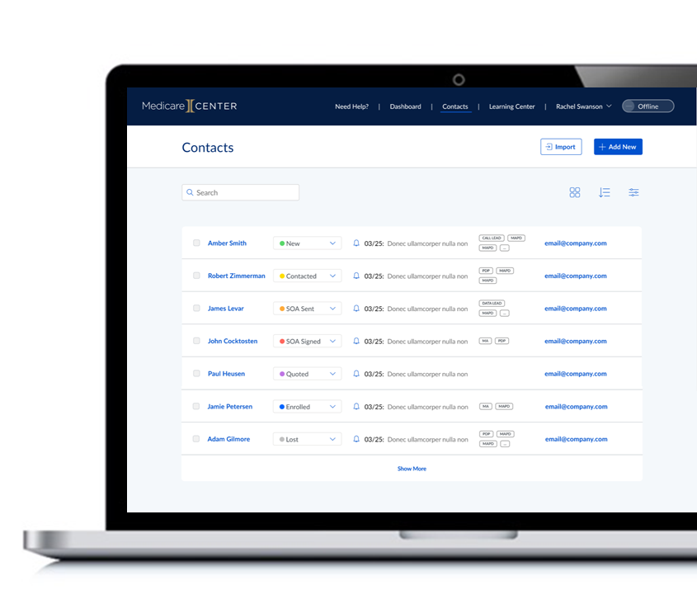
CMS Required Call Recording
The platform includes call scripts, call notes, the ability to automatically connect calls to your clients’ contact record, and more!
It also has the MedicareCENTER support team ready to help.
The best part is, all these useful call recording features and resources are available FREE to you!
Notes:
Jake

Slide 5
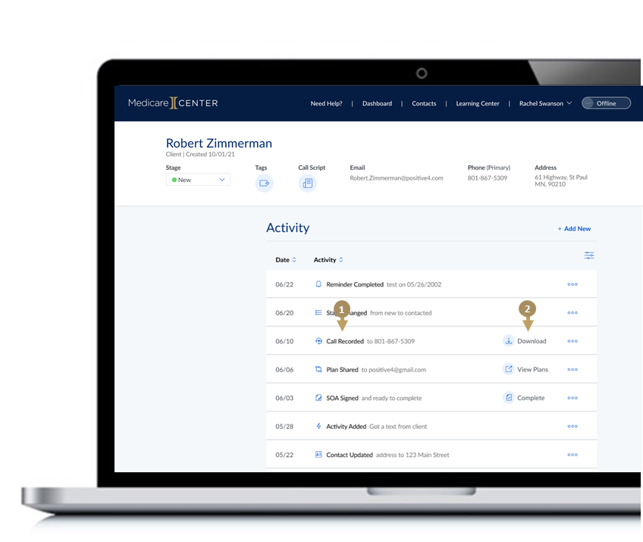
CMS Required Call Recording
MedicareCENTER Call Recording offers also offers you:
Way to connect your call recordings directly to your client list stored within MedicareCENTER’s robust CRM.
This makes it easy for you to keep track of all your call activities — and quickly find calls associated with specific clients.
Every call made to or from clients on your MedicareCENTER contacts list is automatically recorded and saved as an “activity” in that client’s activity feed.
By clicking on the call activity, you can download call recordings and add notes or other details.
Notes:
Jake

Slide 6
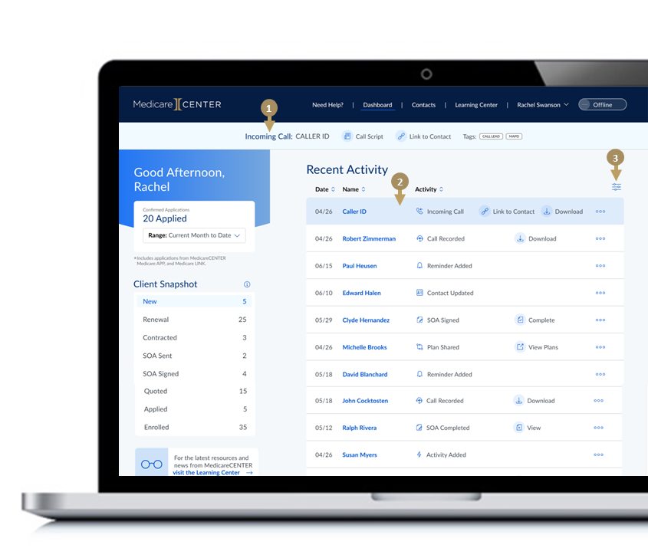
CMS Required Call Recording
When a call comes into MedicareCENTER, an incoming call bar appears, and mobile application users receive an additional push notification.
Calls made to or from numbers that aren’t yet connected to your client list are saved in Recent Activity.
A full call history log is kept on your updated MedicareCENTER dashboard, making it easy for you to create new a client profile.
Once the profile is created, all future calls with that client will automatically be recorded and attached to the client’s page — you’ll always know right where to find them!
Need to find a specific call? You can easily filter by client name and be ready to review with just a few clicks!
Notes:
Jake

Slide 7
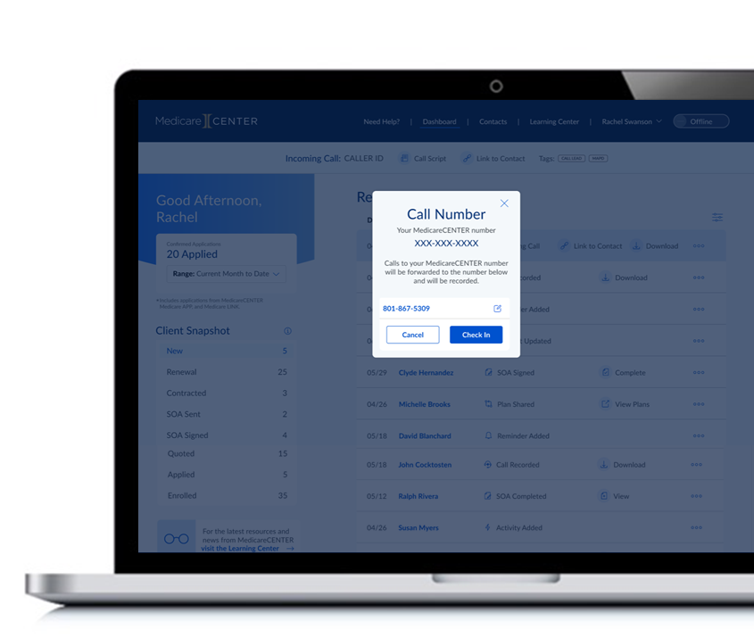
CMS Required Call Recording
With MedicareCENTER Call Recording, you can choose and change which phone receives incoming calls.
Mobile and desk phones are both supported.
Notes:
Jake

Slide 8
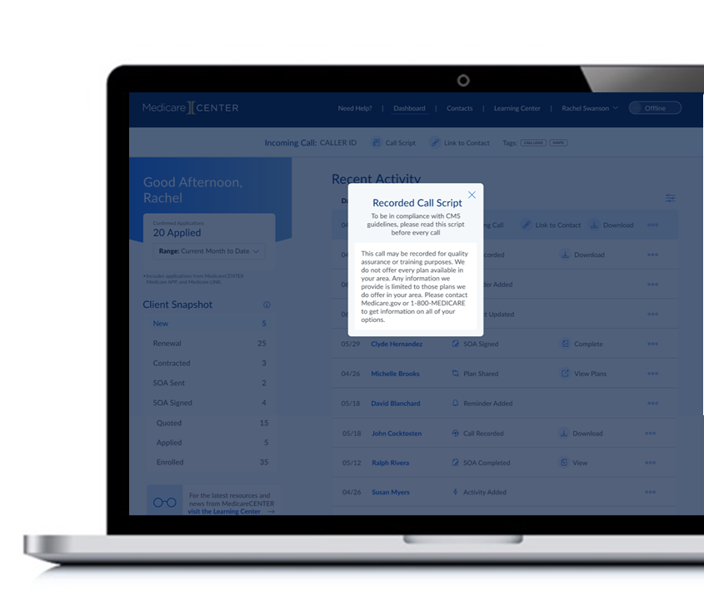
CMS Required Call Recording
A call script with CMS-required talking points is then displayed, which makes it easy for you to share them within the first minute of each sales call.
You’ll also see useful tags that identify which marketing campaigns the call came from, or if there are any suggested activity recommendations.
You can easily access the script and tag information on your client’s contact record.
Notes:
Jake

Slide 9
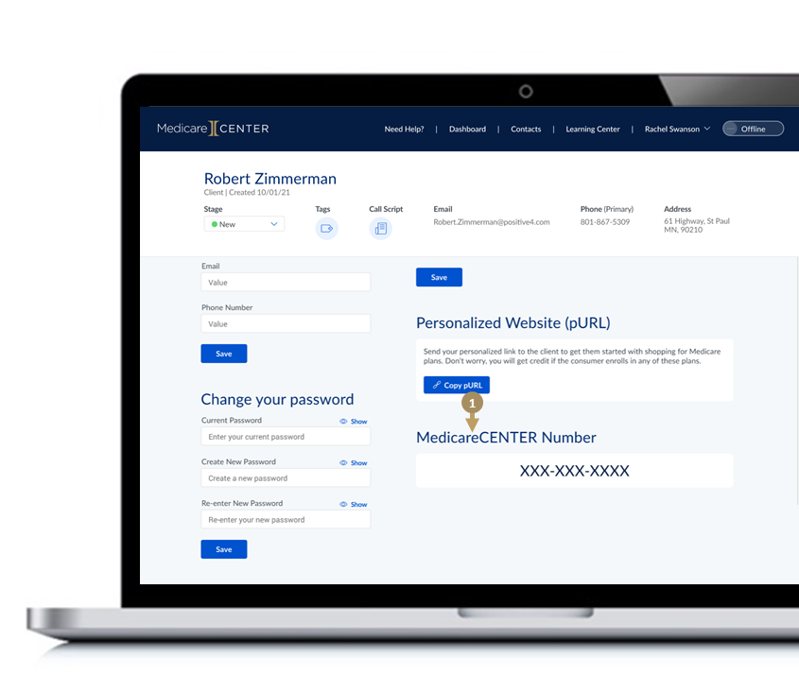
CMS Required Call Recording
All these convenient call recording functions are powered by a unique MedicareCENTER phone number that’s assigned to you.
Because the number is yours and yours alone, you can use it on marketing and other materials.
Every call made to your unique MedicareCENTER phone number is recorded automatically.
This makes it simple to keep all your client phone correspondence in one place — and have access to your call recordings in an instant.
Notes:
Jake

Slide 10
MedicareCENTER Call Recording is an exciting new feature that we’re thrilled to offer at FREE to you – we’ll be releasing it soon!
It’s built to help you to stay compliant as you continue to expertly serve the complex needs your clients. And it’s one more way MedicareCENTER can help you be even more efficient and effective as an agent.
Notes:
Jake

Slide 11
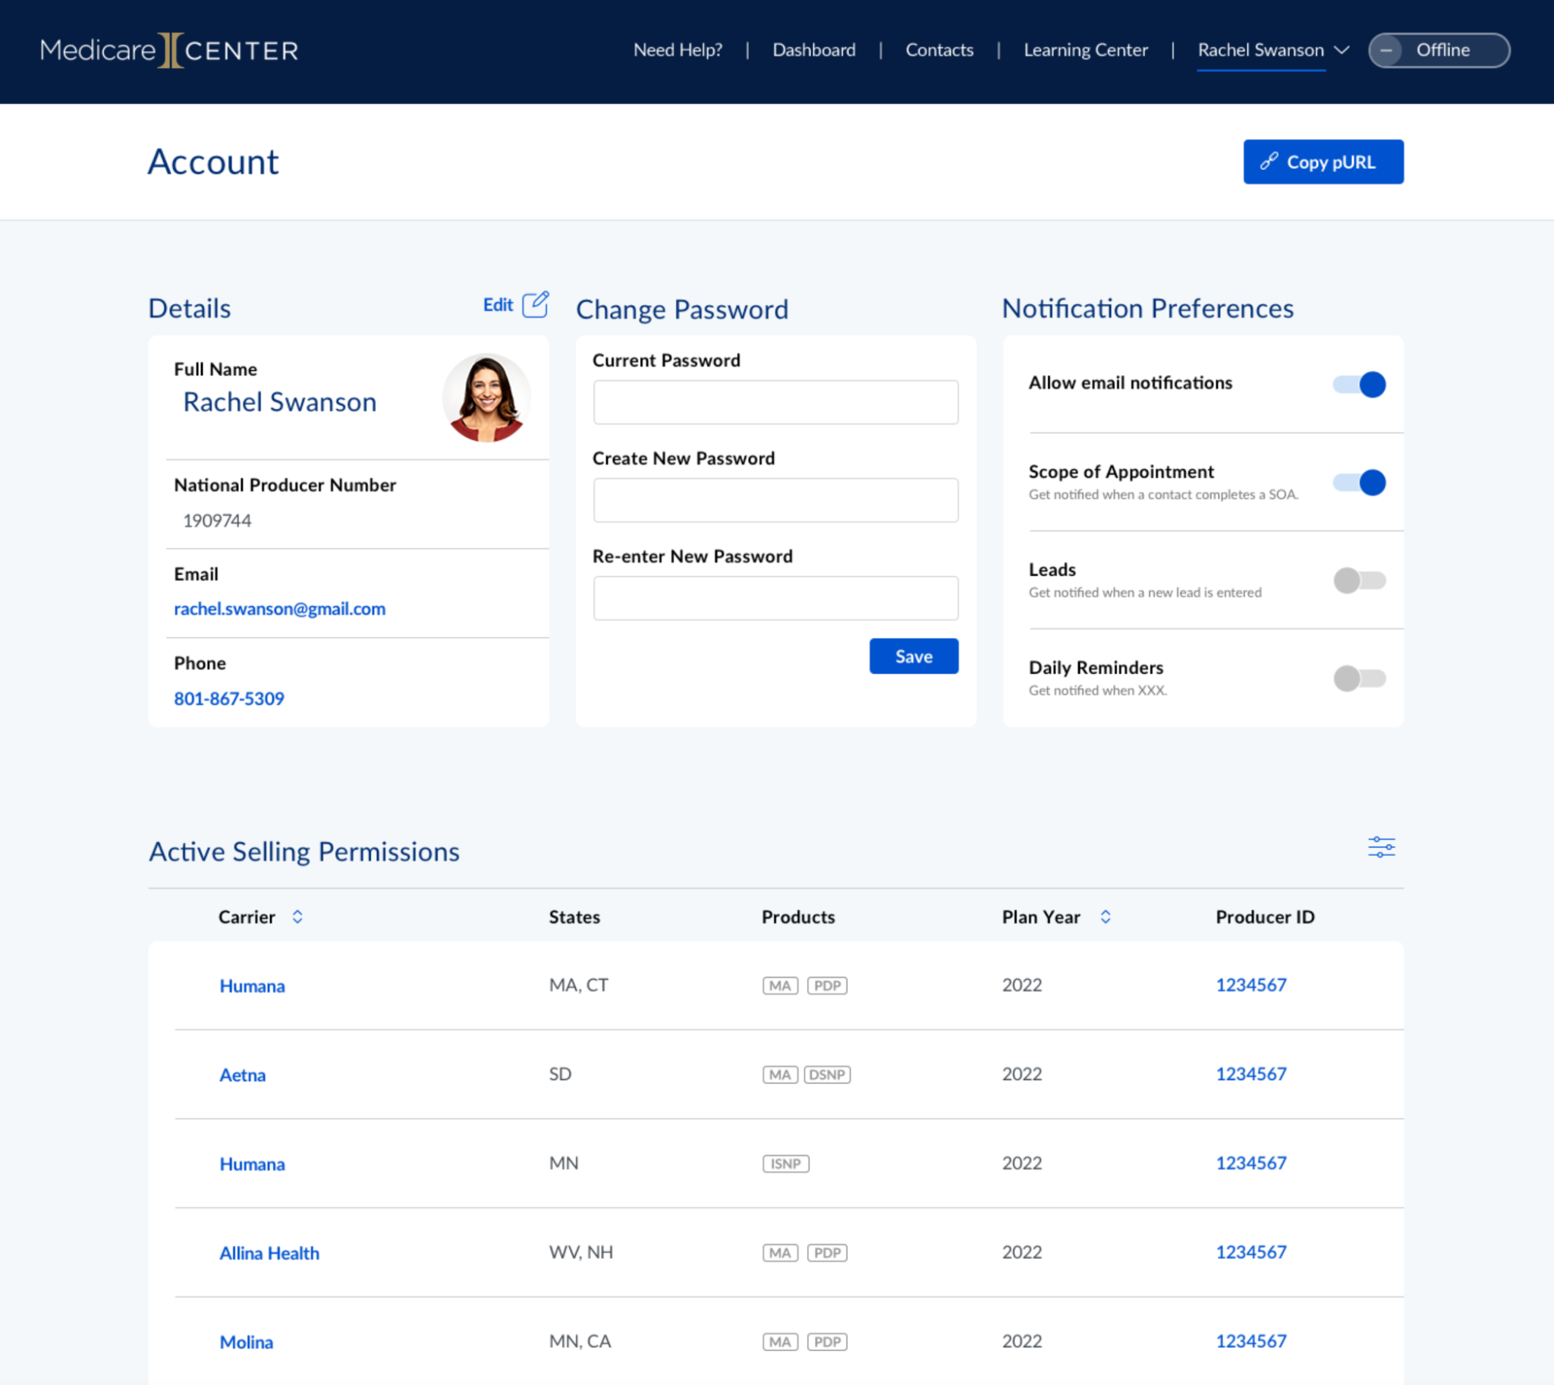
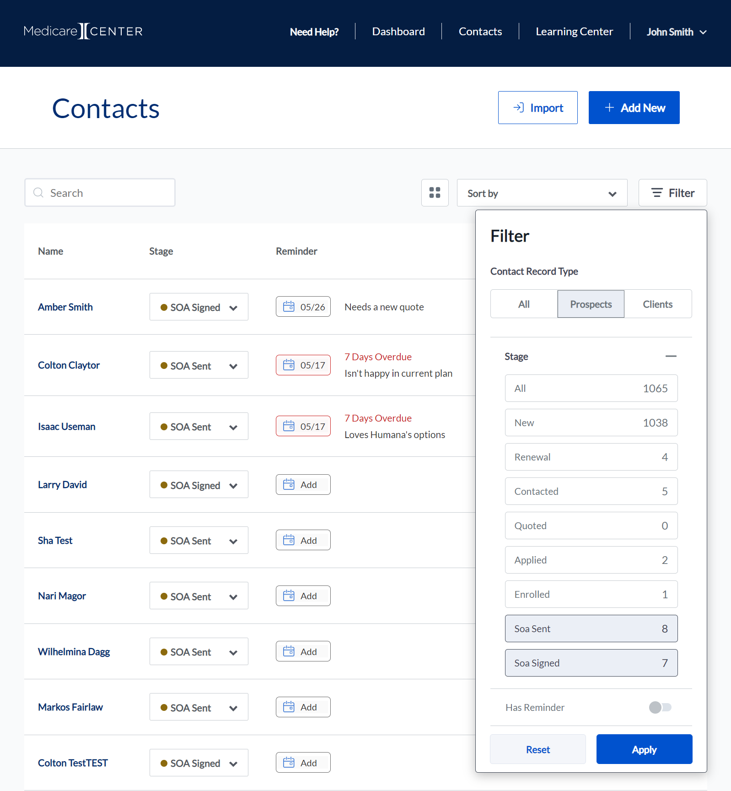
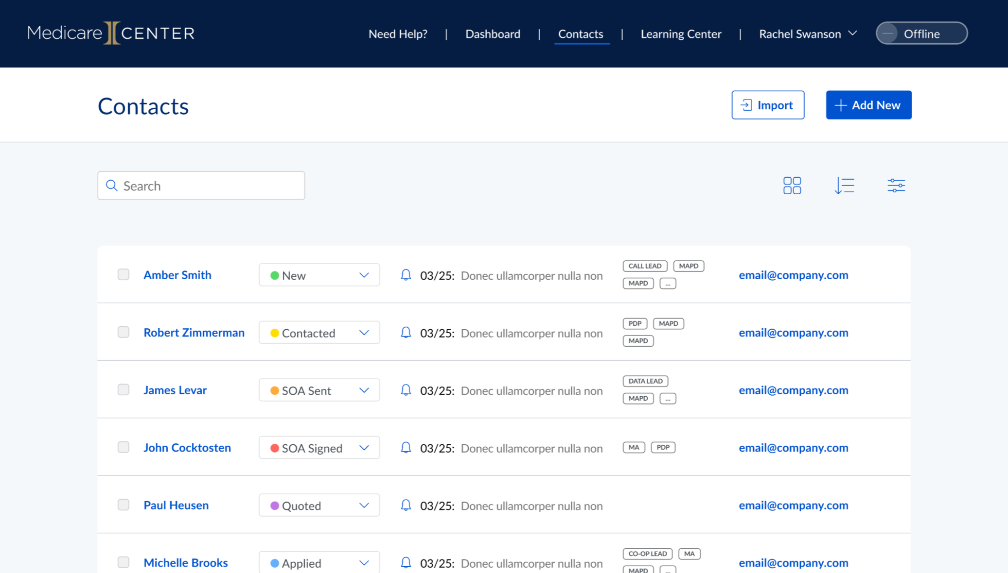
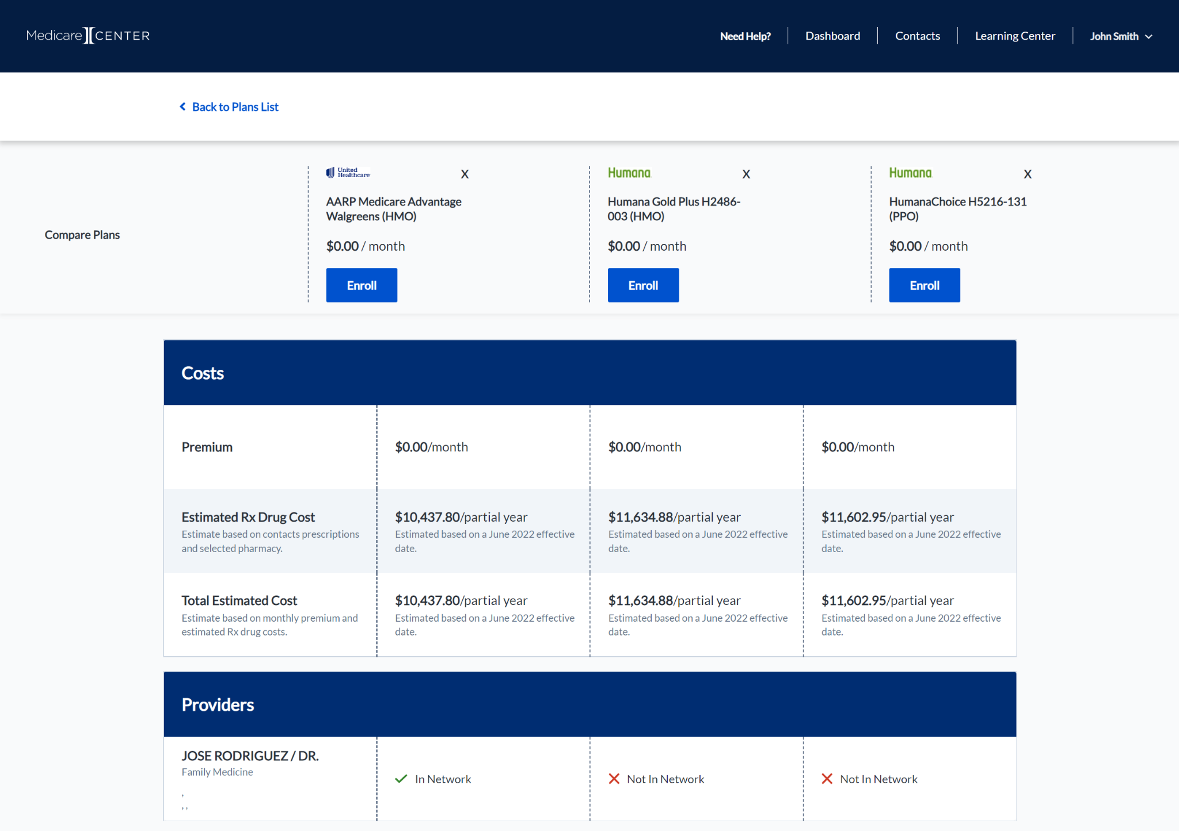
Additional MedicareCENTER features will continue to be designed and rolled out, and we are excited for upcoming releases that will help drive an even more successful AEP!
RTS View
Advanced Filters, Compare, Expanded Disposition
Additional Upcoming New Features Include:
CMS Required Call Recording & Scripts
“Check In” Availability Toggle
Lead Buying and Routing
Ready to Sell View
Tagging
Agent Personal Sites
Switchers Recommendation
Cross Sell / Up Sell Recommendation Engine
Tagging
Notes:
Jake

